Slide 1



Optimizing Emergency Department (ED) Throughput & Patient Flow
Charles Nicolle Hospital
Presented by
Mohamed Aziz Amri
Mohamed Dhia Ben Kilani
Elaa Chaaleb
Wassef Bellila
26, JANUARY 2026

Slide 2
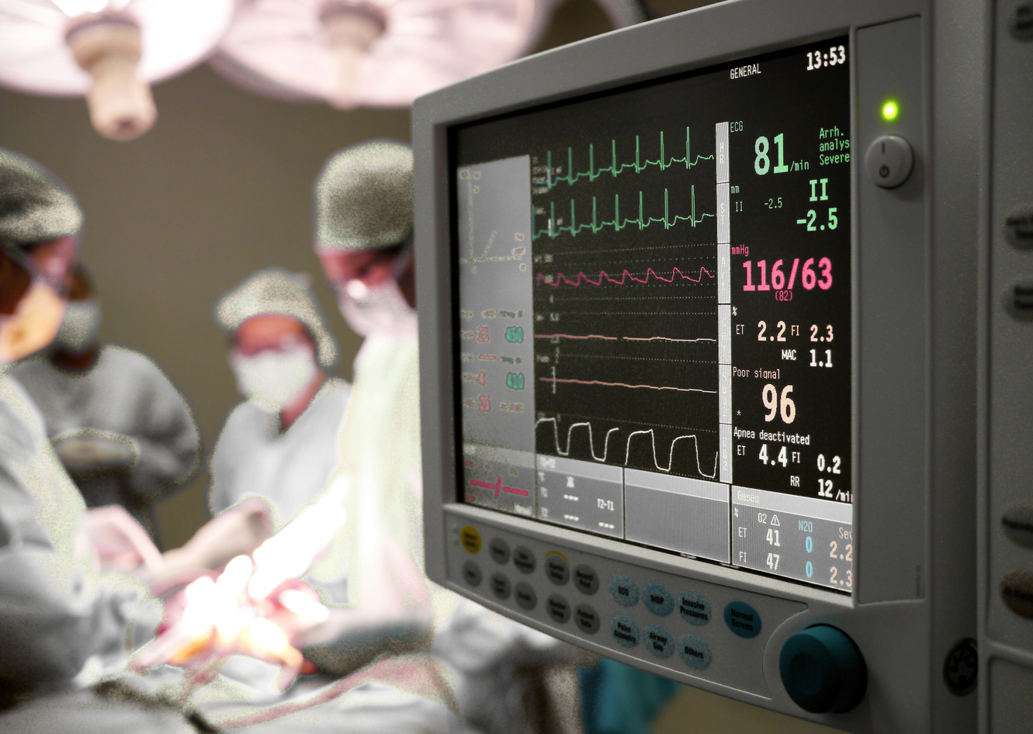


TABLE OF CONTENT
01
05
ORGANISATION OVERVIEW
SCHEMA DESIGN
02
06
BUSINESS PROBLEM
DATA VISUALIZATION
03
07
BI SOLUTION
KEY INSIGHTS
04
08
ETL PROCESS
RECOMMENDATIONS
09
CONCLUSION

Slide 3



Organization Overview
Charles Nicolle Hospital (Hôpital Charles-Nicolle) is a premier public university hospital (CHU) located in the Bab Saadoun district of Tunis, Tunisia. It stands as one of the country's most significant and oldest healthcare institutions. Established in 1897 as the "Hôpital Civil Français”, It serves as a national referral center, providing specialized care for patients from across the entire country, not just the capital.

Slide 4

BUSINESS PROBLEM
BI SOLUTION
The Emergency Department is facing persistent overcrowding and inefficiencies in patient flow. Average waiting times exceed industry benchmarks, and critical resources such as beds and staff are frequently overstretched. The absence of integrated performance visibility prevents administrators from clearly identifying operational bottlenecks.
This project aims to develop a Business Intelligence solution that visualizes the end-to-end Emergency Department patient journey. The solution will support the identification of throughput bottlenecks and enable data-driven operational decisions.

Slide 5


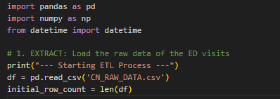

ETL PROCESS
DATA EXTRACTION
Extraction of data from the csv file

Slide 6




DATA TRANSFORMATION
ETL PROCESS
Removing duplicates
Convert all time fields to a consistent format

Slide 7

ETL PROCESS
DATA TRANSFORMATION
Impute or remove records with missing time data
Remove records with no time data
Correct invalid time order

Slide 8

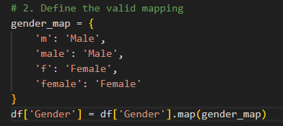
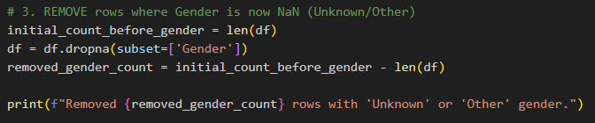

DATA TRANSFORMATION
ETL PROCESS
Standardize gender values/Normalize gender formatting
Map to Male/Female
Drop invalid gender records

Slide 9

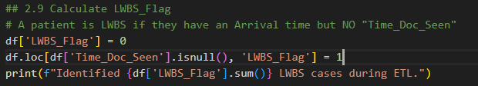
DATA TRANSFORMATION
ETL PROCESS
Remove invalid ages
Fill missing critical fields/Apply default acuity value/Apply placeholder IDs.
Cap extreme boarding times
Flag patients not seen

Slide 10

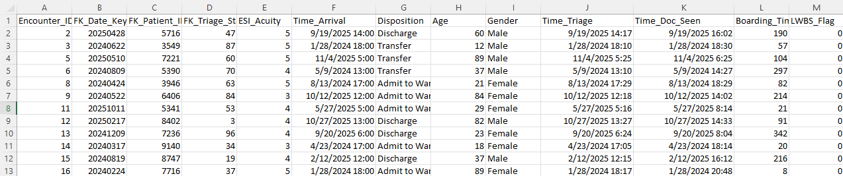
A SNAPSHOT AT THE CLEANED DATA

Slide 11

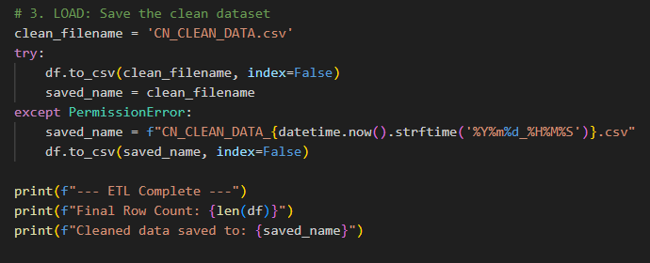

DATA LOADING
ETL PROCESS
Export the cleaned dataset to a CSV file for reporting and dashboards.

Slide 12
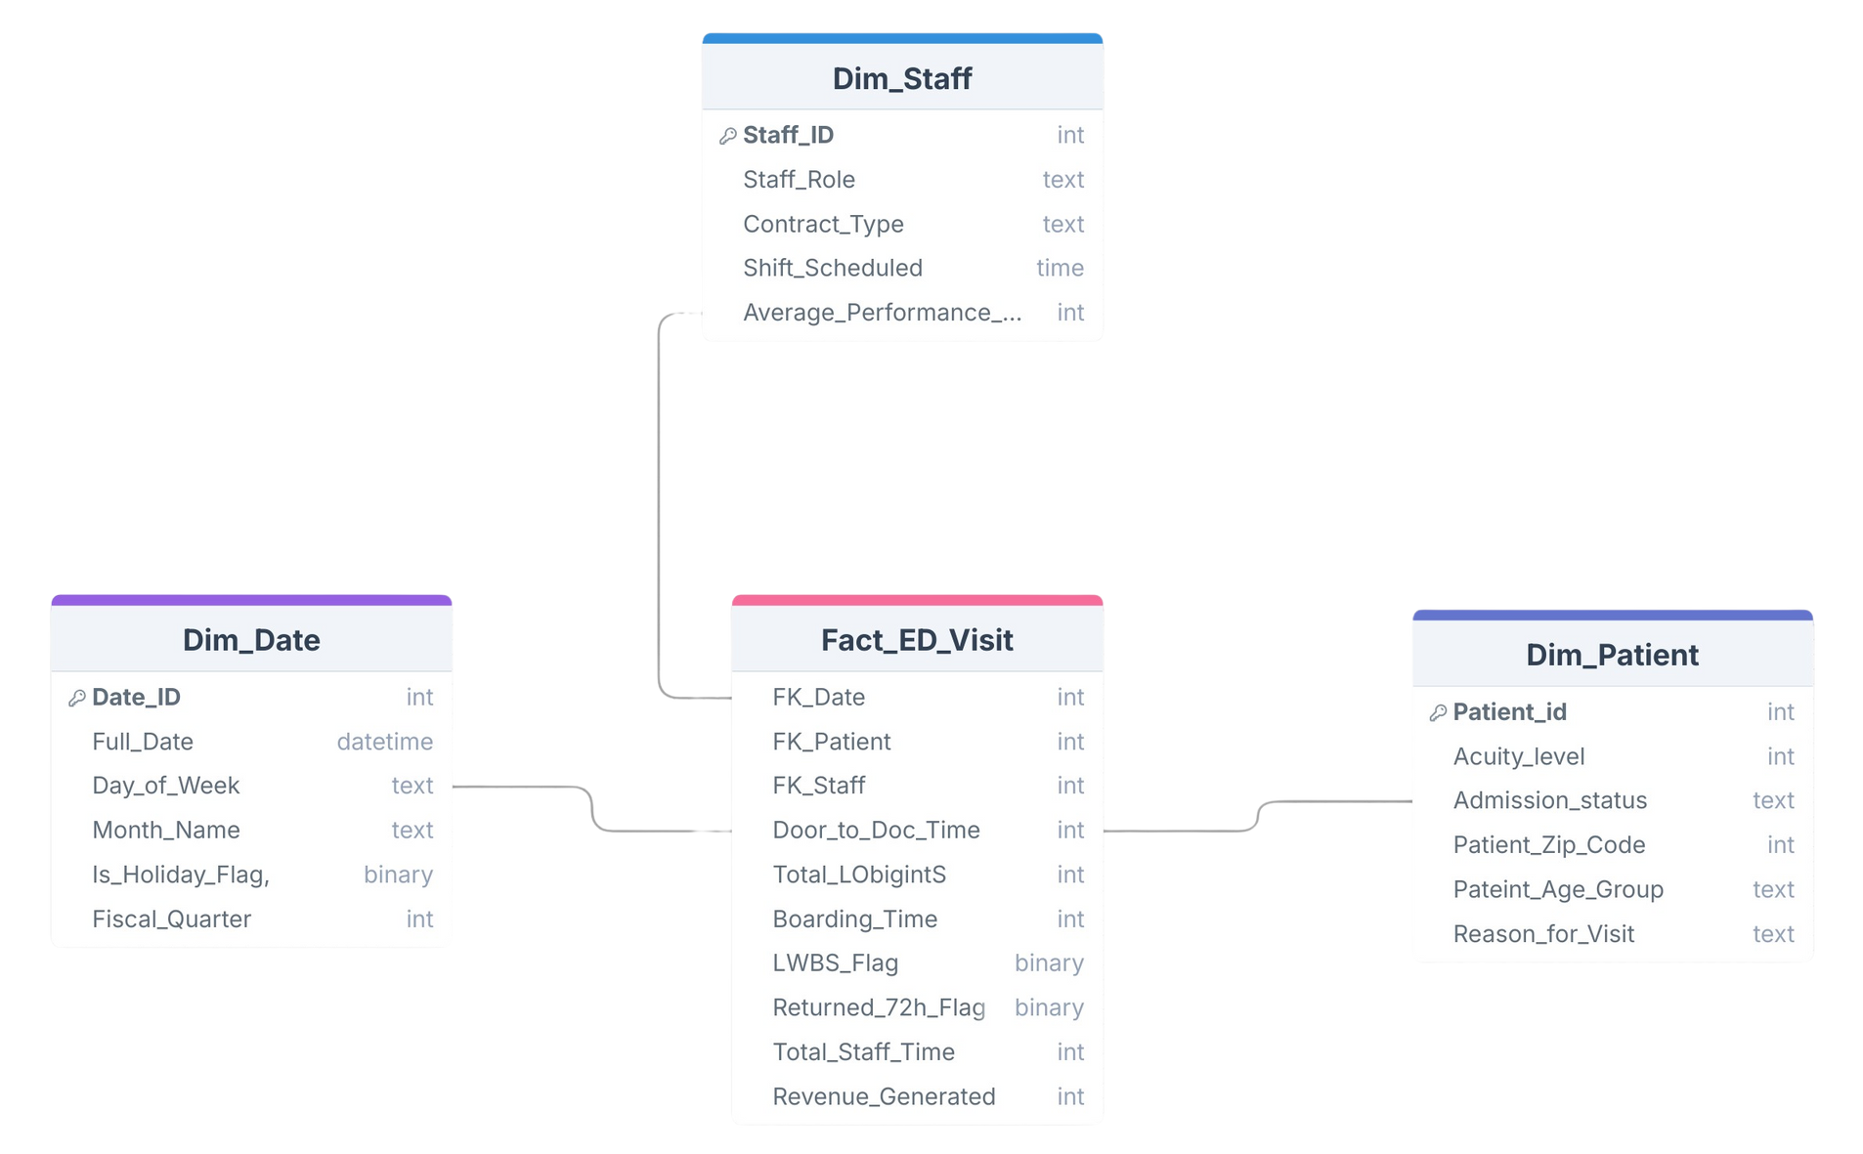

SCHEMA DESIGN

Slide 13
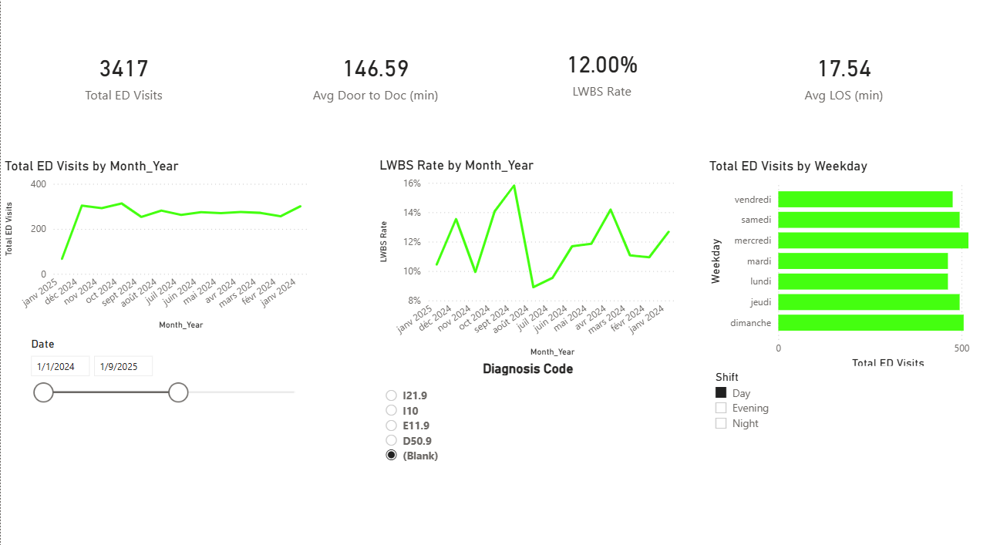
DATA VISUALIZATION
EXECUTIVE SUMMARY
DASHBOARD

Slide 14





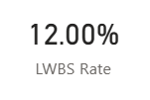



Core Performance Metrics: The Waiting Gap
Slicers
Diagnosis Code All
Period
LWBS Rate
Shift Day
The facility managed 3,417 total visits with an arrival-to-triage time of 17.54 minutes. While this initial processing time is just slightly above the 15-minute industry standard, it reveals a relatively efficient "front door". The critical failure point is the secondary wait: patients spend an average of 146.59 minutes (nearly 2.5 hours) from arrival until they actually see a doctor. This massive gap between being triaged and being seen by a physician is the primary driver of the 12.00% LWBS rate, indicating that patients are willing to be "checked in" but lose patience during the prolonged wait for clinical intervention.
Executive Summary

Slide 15


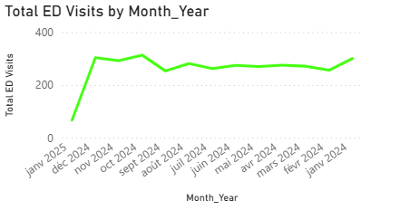

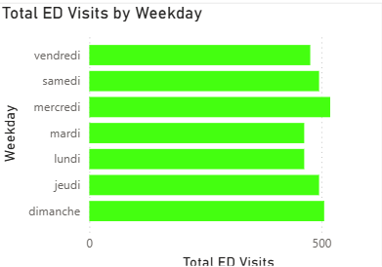

Volume Trends: The Mid-Week and Weekend Pressure
Slicers
Diagnosis Code All
2025
Period
Presentation
Shift Day
Temporal analysis shows that the Day shift faces its heaviest pressure on Wednesdays (mercredi), where volume peaks at over 500 visits, followed closely by Saturday and Sunday. Monthly trends demonstrate a sustained "high-volume" season from November 2024 through August 2024, where monthly visits consistently exceed 300
Executive Summary

Slide 16
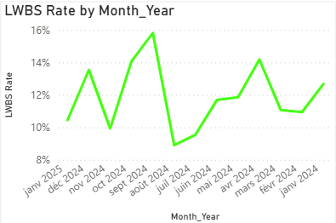

Attrition Volatility: Capacity Tipping Points
Slicers
Diagnosis Code All
2025
Period
Presentation
Shift Day
The LWBS Rate exhibits extreme seasonal sensitivity, characterized by a dramatic spike to nearly 16% in September 2024—a sharp reversal from the year's low of 9% in August 2024. This volatility suggests that the Day shift is operating at a precarious capacity threshold where even minor fluctuations in patient volume or staffing can cause a nearly 80% increase in patient attrition.
Executive Summary

Slide 17
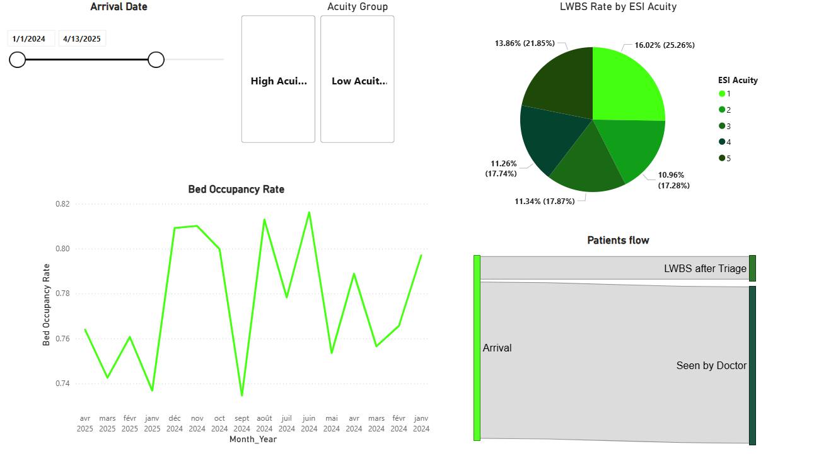
Operational Performance & Throughput Intelligence
Dashbaord

Slide 18

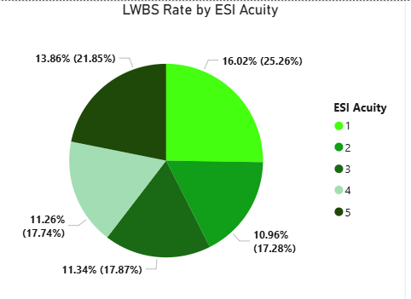

Patient Flow & Acuity: High-Stakes Bottlenecks
A comparative analysis reveals a critical safety paradox: the highest attrition occurs among the most urgent cases. In the High Acuity group, ESI 1 patients exhibit a staggering 16.02% LWBS rate, which is significantly higher than the peak attrition in the Low Acuity group (13.86% for ESI 5). This indicates a severe failure in prioritizing immediate clinical intervention for the most vulnerable arrivals.
PERIOD

Slide 19

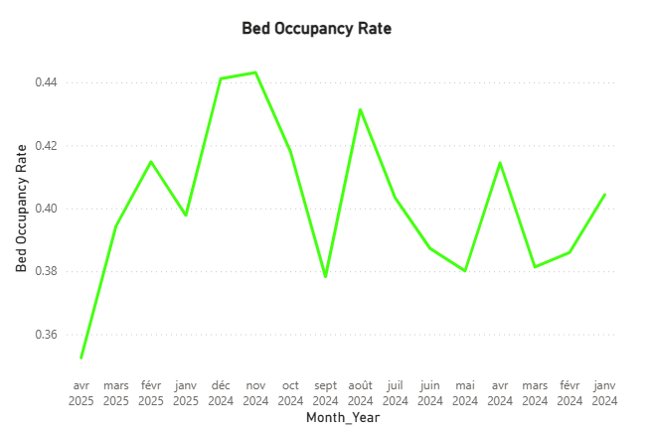
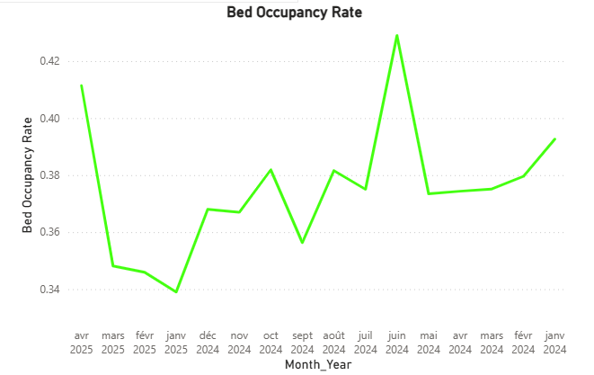
High Acuity
Low Acuity
A comparison of bed occupancy trends reveals a distinct seasonal divergence between patient groups. High Acuity occupancy is characterized by a sustained late-year surge, peaking at approximately 0.44 (44%) during November and December 2024. In contrast, Low Acuity occupancy follows a different cycle, reaching its primary peak of 0.43 (43%) much earlier, in June 2024, before hitting a significant low of 0.34 (34%) in January 2025. These divergent peaks suggest that while the facility faces overall capacity pressure, the nature of the demand shifts from minor care needs in the summer to critical clinical requirements during the winter, necessitating a seasonal recalibration of bed allocation and specialized staffing.

Slide 20
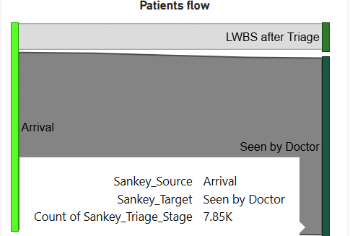
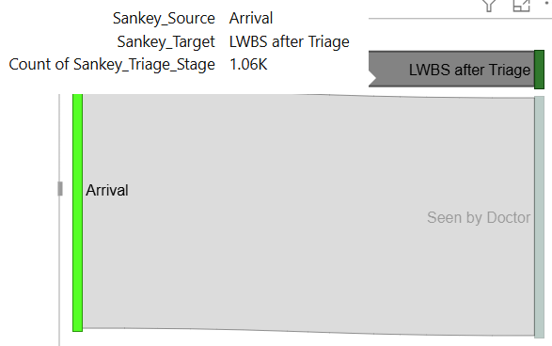
LWBS After Triage
High Acuity
530
Low Acuity
527
The Sankey diagrams reveals that High Acuity and Low Acuity groups contribute almost equally to the facility's total attrition, despite their vast difference in clinical urgency. Out of the 1.06K total LWBS (Left Without Being Seen) patients, the volume is split nearly down the middle:
High Acuity Attrition (ESI 1–3): This group accounts for 530 patients who left after triage without medical intervention. Given these patients have higher clinical needs, this represents the highest risk tier for the hospital.
Low Acuity Attrition (ESI 4–5): This group accounts for 527 patients leaving before being seen. While common in ER settings due to long waits for minor issues, this volume matches the high-acuity departures.

Slide 21
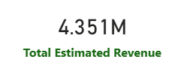
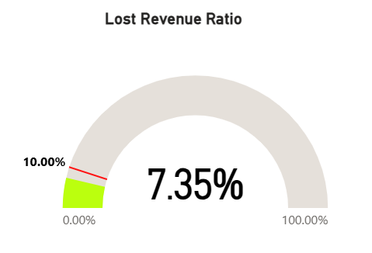
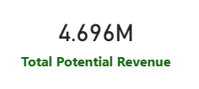
Financial Impact :
Lost Revenue Dashboard
LWBS Ratio
12.13%
INSIGHTS
Inefficiency has a clear price tag: $345,000 in lost revenue due to the LWBS rate. While the current Lost Revenue Ratio of 7.35% sits below the 10% critical threshold (as shown in the gauge), it represents a significant opportunity for recovery.
(↓2%)

Slide 22

Key Insights
The Wait-Time Paradox
Critical Clinical Leakage
Systemic Failure in Prioritization
While the initial arrival-to-triage time is relatively efficient at approximately 17 minutes, it is overshadowed by a massive secondary bottleneck—an average Door-to-Doc wait of over 146 minutes.
This prolonged wait for a physician is the primary driver of a 12%+ LWBS rate, where high-acuity patients (ESI 1) are leaving at a staggering 16.02% rate—surpassing even the lowest-urgency cases.
The parity in raw departure numbers between High Acuity (530) and Low Acuity (527) patients confirms that systemic bottlenecks are impacting life-threatening cases just as heavily as minor ones.

Slide 23
Predictable Capacity Tipping Points
The Financial Toll of Inefficiency
Demand is not random; it peaks predictably on Wednesdays and Weekends, with a seasonal surge in High Acuity bed occupancy reaching 44% during the year-end winter months.
This operational attrition is not just a safety risk; it has a direct financial cost, resulting in $345K in lost revenue and representing a 7.35% lost revenue ratio.

Slide 24


Recommendations
Implement "Provider-in-Triage" (PIT): To combat the 146-minute Door-to-Doc delay, place a physician or advanced practitioner in triage during peak hours to initiate orders and clinical intervention immediately.
High-Acuity Throughput Protocol: Develop a dedicated "Fast-Track" for ESI 1 and 2 patients to ensure that the most critical 30% of your arrival volume is prioritized, specifically targeting the reduction of the 16.02% ESI 1 LWBS rate.
Seasonal Bed Surge Management: Establish a flexible bed management plan for November and December to accommodate the documented 44% peak in High Acuity occupancy, preventing the "capacity-related leakage" of critical patients.
Revenue Recovery Target: Focus on capturing even 50% of current LWBS volume to recover approximately $172K in annual revenue, making operational speed a primary KPI for the hospital’s financial health.

Slide 25
CONCLUSION
The Emergency Department is currently at an operational crossroads where prolonged physician wait times are directly undermining both patient safety and financial stability.
Patient departures follow predictable weekly and seasonal patterns, thus, the path forward requires transitioning from static staffing to a dynamic, demand-responsive model. By prioritizing high-acuity throughput and closing the "waiting gap," the facility will not only mitigate significant clinical and liability risks but also capture substantial revenue that is currently being lost to system inefficiency.

Slide 26

THANK YOU

